Slide 1
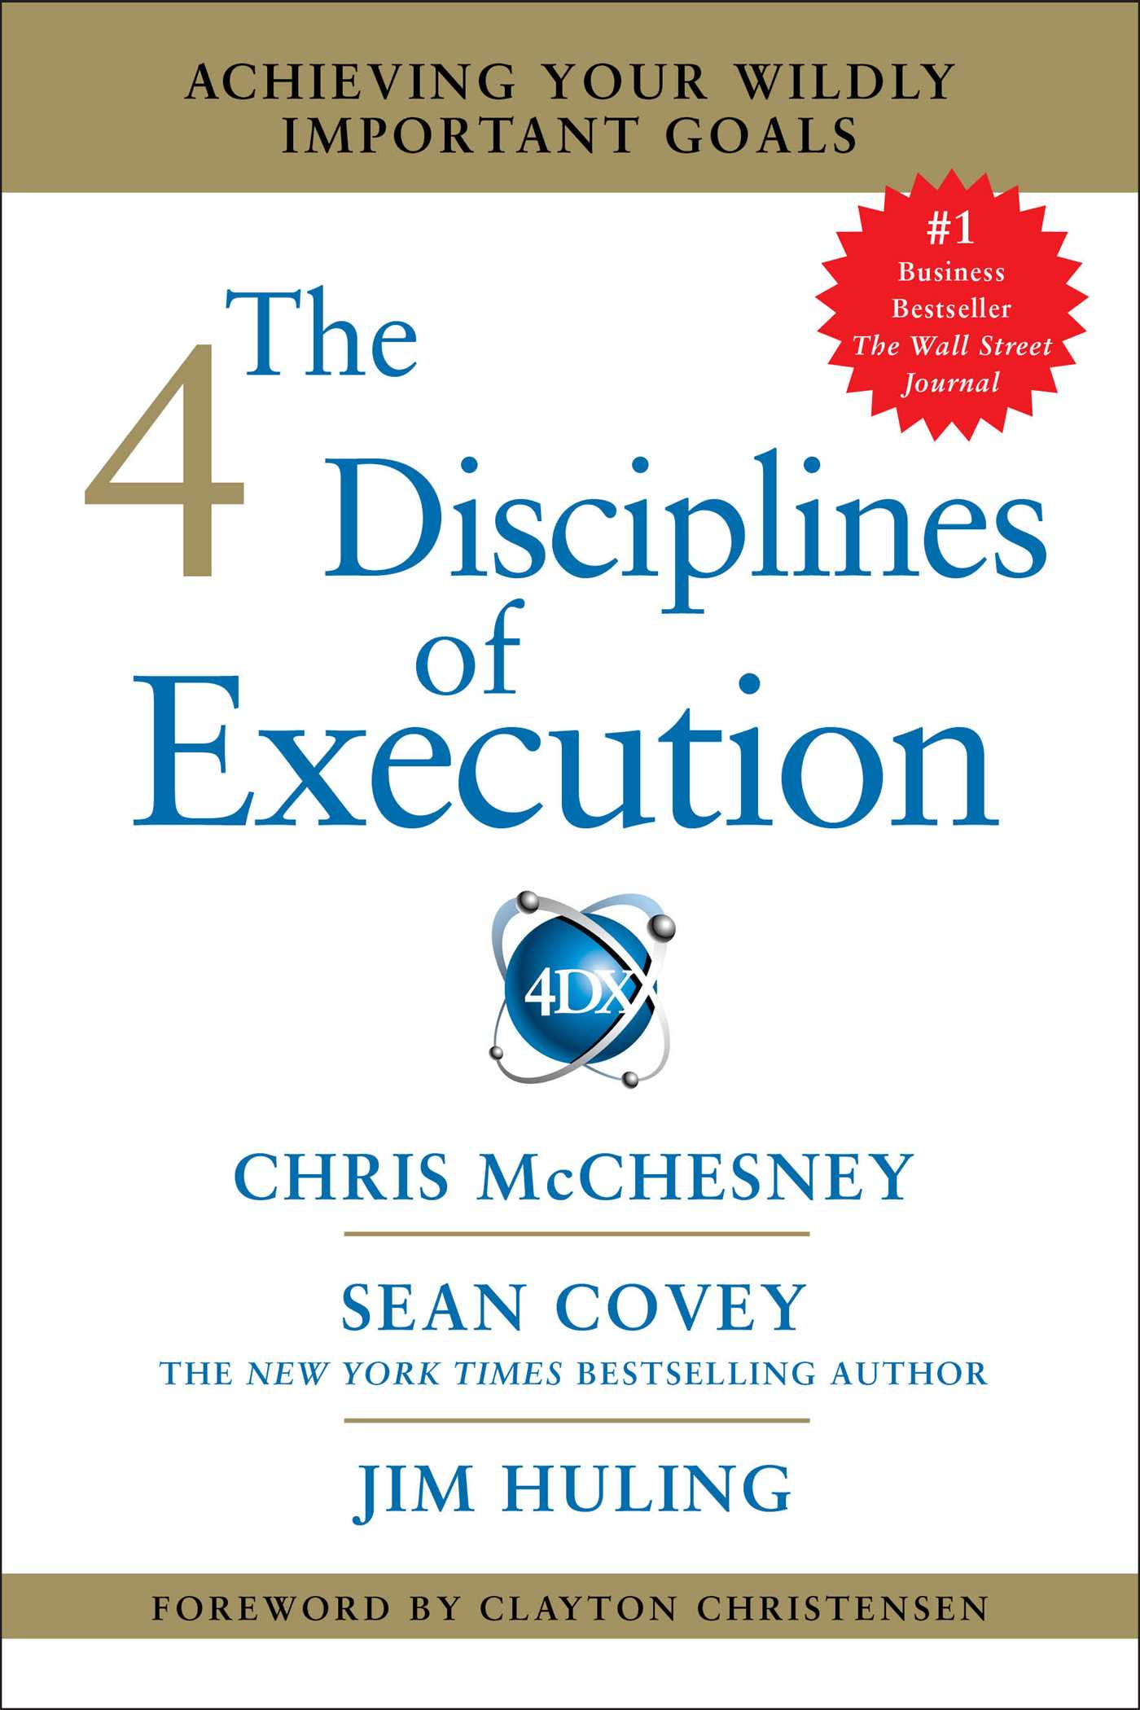
The 4 Disciplines of Execution
By Harry Nieto - Network Texas Self DEVELOPMENT

Slide 2
Discipline #1 Focus on the wig
WIG: wildly important goal.
This is the discipline of focus!
Select 1 (no more than two) WIGs.
It is impossible to improve everything at once.
Be clear to yourself and your team that this is the goal that matters most.

Slide 3
Discipline #2 act on lead measures
Measure of the most high-impact things you or your team can do to reach the goal.
Measure new behaviors that will drive success on the LAG measures.
2 basic characteristics
Predictive of achieving the goal
can be influenced by the team members.
Example:
Lose 20 pounds is a LAG measure
Limit of daily calories and X No. of hours of exercise a day are lead measures

Slide 4
Discipline #3 Keep a compelling scoreboard
This is the discipline of engagement.
Know if you are winning or losing.
The highest level of performance always comes from the people who are emotionally engaged.
The highest level of engagement comes from knowing the score.

Slide 5
Discipline #4 Create a cadence of accountability
The magic is in the cadence.
Unless we consistently hold each other accountable, the goal naturally disintegrates in the whirlwind .
The cadence of accountability is a rhythm of regular and frequent check-points.
Review with a team weekly no more than 20-30 minutes.

Slide 6
So what next? Here is my challenge.
Get your own copy of the book. Learn and start executing.
Join me on facebook.com/yearofchange2018
Web Resource: harrynieto.com
If you do not have a team, get an accountability partner to help keep the cadence going.
Let’s plan a break-out session after our meeting on Feb.9th for a book discussion and WIG review.

